Slide 1
DOCTORAL RESEARCH • APPLIED PORTFOLIO
Employee Rewards and Work Performance in Undesirable Locations
VALENTINE OKECHUKWU UKANDU, PhD
Applied Management
Federal Acquisition
Healthcare & Public-Sector Operations
A visual research briefing for leadership, teaching, speaking, and federal consulting
2022 • Walden University
Companion asset: 3-minute visual summary
Notes:
Open by positioning the dissertation as a practical leadership study, not only an academic milestone. The deck is designed as a reusable master briefing: the research core remains constant while the application changes for professional, teaching, speaking, and federal audiences.
[Sources]
- https://scholarworks.waldenu.edu/dissertations/12575/ — dissertation record
- https://www.youtube.com/watch?v=-Sdsd8hB72A — public visual-summary source
[/Sources]

Slide 2
DISSERTATION → PRACTICE
One research asset can serve five distinct audiences
Keep the evidence consistent. Change the audience outcome, format, and call to action.
1
2
3
4
5
Professional
website
LinkedIn
profile
Teaching
portfolio
Speaking
engagements
Federal consulting
business
Build authority
Create reach
Enable learning
Win invitations
Support buyers
Core message
Rewards work when employees believe effort leads to valued, reliable outcomes.
02
Notes:
This is the deck's organizing principle. The dissertation should not be copied word-for-word into every channel. The research claim and evidence remain stable, but each channel answers a different audience question: Why should I trust this expert? What can I learn? What can this speaker deliver? How can this consultant support the mission?
[Sources]
- https://scholarworks.waldenu.edu/dissertations/12575/ — research scope and findings
[/Sources]

Slide 3
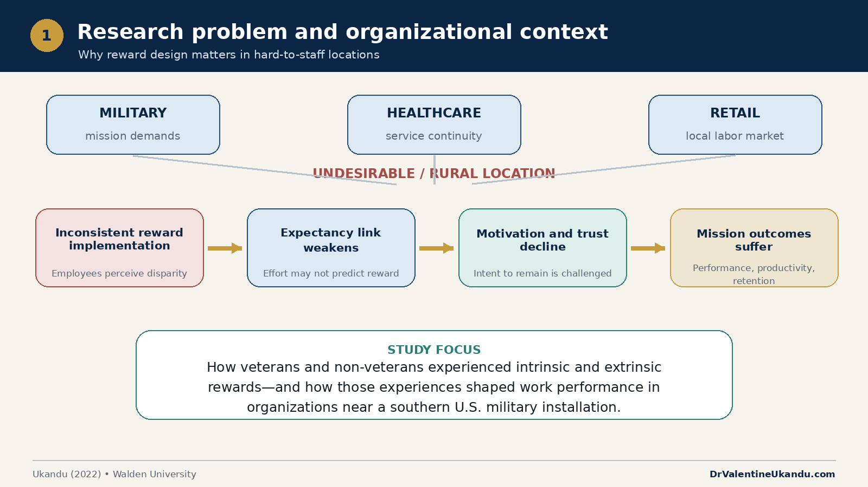
Notes:
Explain the practical problem: in hard-to-staff locations, an inconsistent or irrelevant reward system weakens the expected connection between effort, performance, and valued outcomes. Emphasize that the study crossed military, healthcare, and retail settings.
[Sources]
- https://scholarworks.waldenu.edu/dissertations/12575/ — study purpose, sectors, and research context
[/Sources]

Slide 4
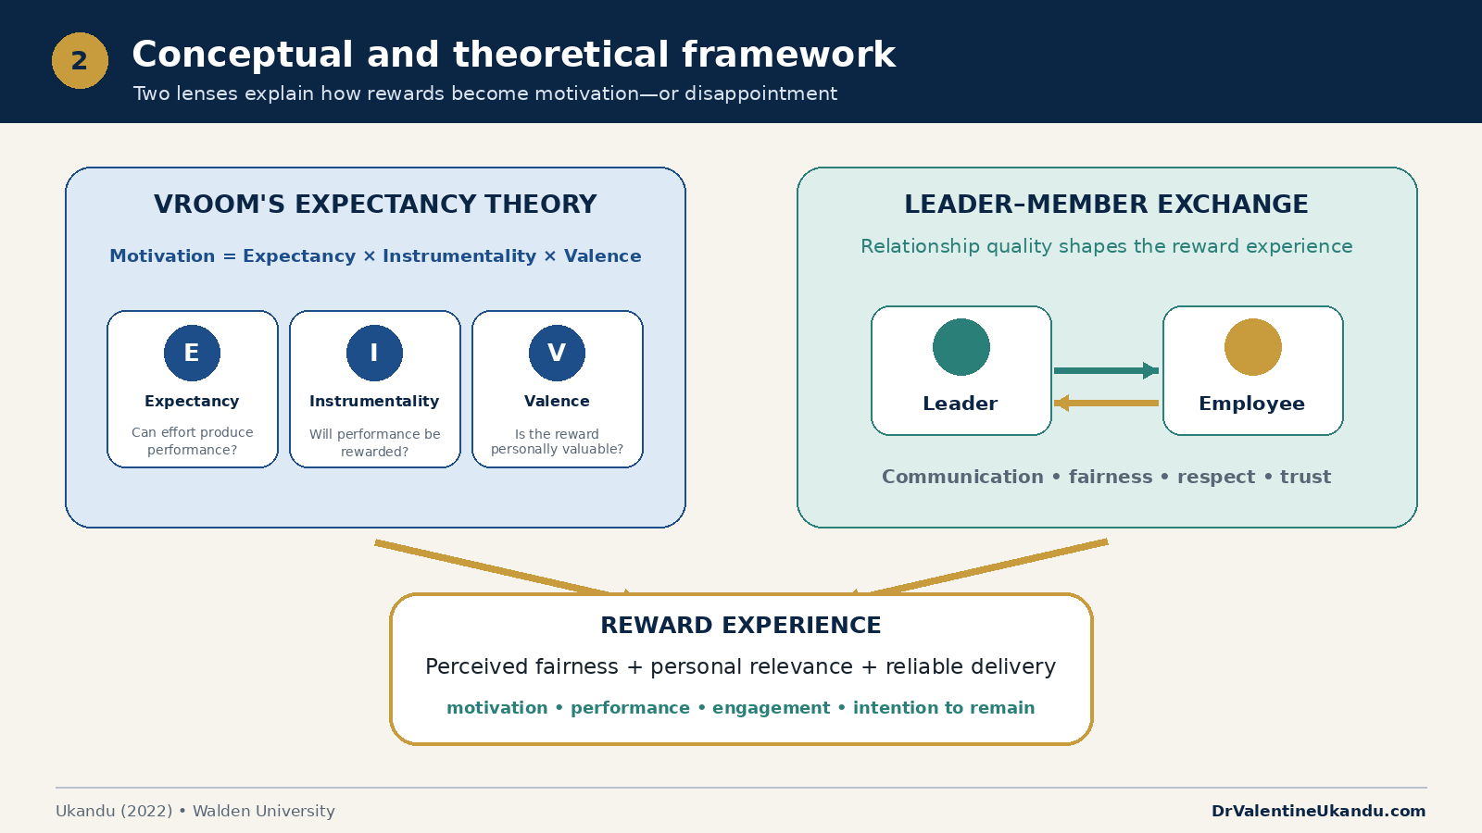
Notes:
Use the two frameworks as complementary lenses. Vroom explains the effort-to-outcome calculation; leader-member exchange explains how trust, fairness, communication, and relationship quality shape the reward experience.
[Sources]
- https://scholarworks.waldenu.edu/dissertations/12575/ — dissertation framework
[/Sources]

Slide 5
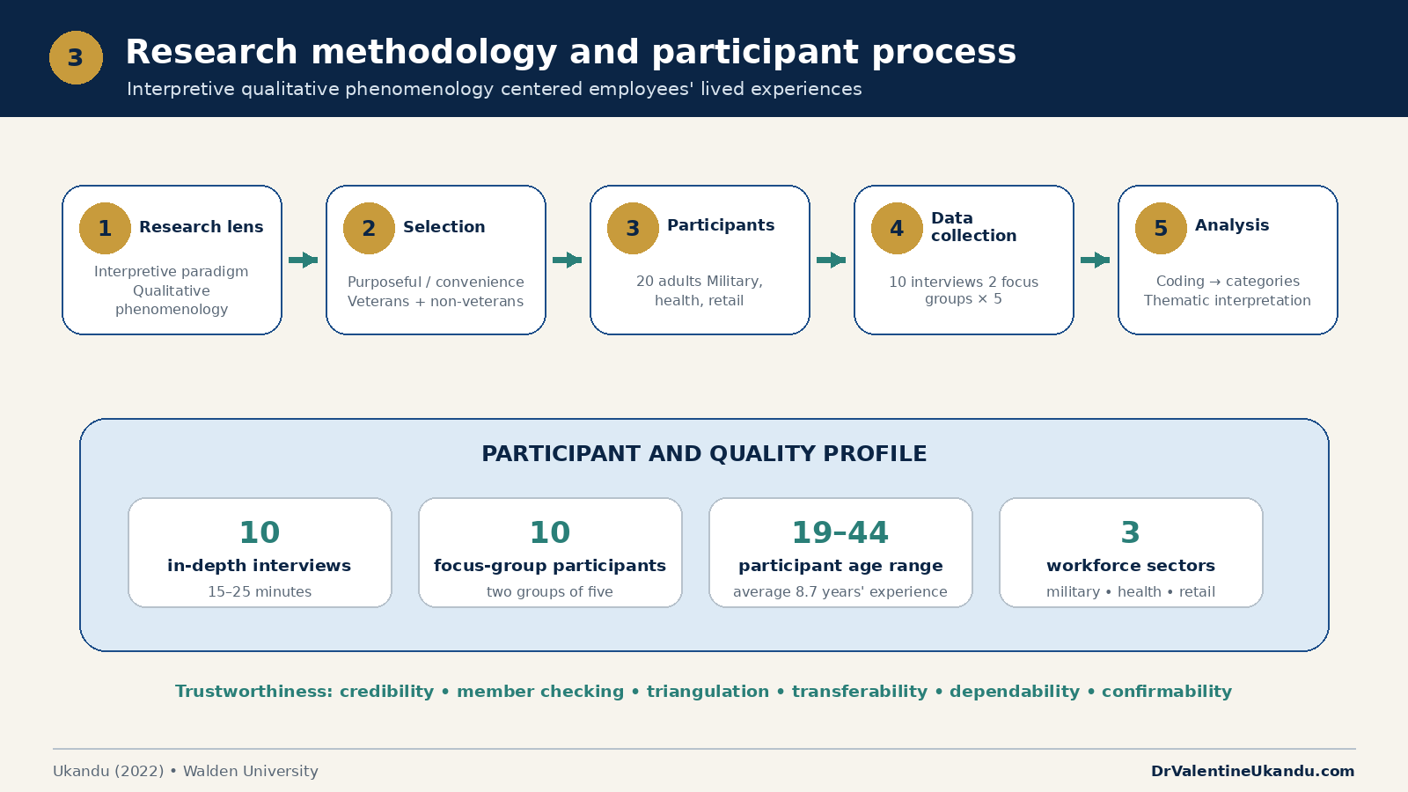
Notes:
Describe the interpretive qualitative phenomenological design. The study included 20 participants across military, healthcare, and retail contexts, using 10 interviews and two focus groups of five, followed by thematic analysis and trustworthiness procedures.
[Sources]
- https://scholarworks.waldenu.edu/dissertations/12575/ — methodology and participant details
[/Sources]

Slide 6
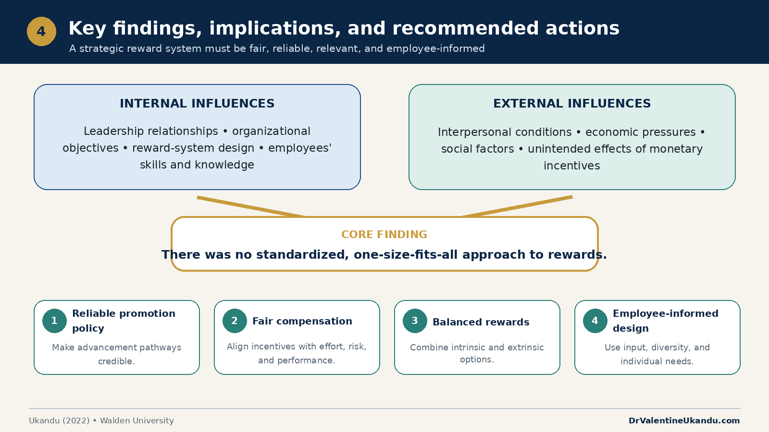
Notes:
The central finding was not that rewards are ineffective. The problem was inconsistency and a lack of strategic fit. A credible system must be reliable, fair, balanced, relevant to employee needs, and clearly implemented.
[Sources]
- https://scholarworks.waldenu.edu/dissertations/12575/ — findings and implications
[/Sources]

Slide 7
DISSERTATION → PRACTICE
Four operating disciplines make reward systems credible
1
Publish the rules
A reward system earns trust when it is…
Make eligibility, timing, and decision rights visible.
2
Audit consistency
FAIR
RELIABLE
RELEVANT
EMPLOYEE-
INFORMED
Compare policy with actual reward decisions across teams.
3
Balance the portfolio
Combine promotion, compensation, recognition, and growth.
4
Listen before redesign
Use employee input to test relevance and credibility.
DrValentineUkandu.com
07
07
Notes:
Translate the study into an operational cadence. Leaders publish reward rules, audit whether practices match policy, balance financial and nonfinancial rewards, and use employee input before redesigning the system. The management goal is credibility: employees must be able to predict how valued performance is recognized.
[Sources]
- https://scholarworks.waldenu.edu/dissertations/12575/ — findings and recommended actions
[/Sources]

Slide 8
APPLICATION • PROFESSIONAL WEBSITE
Make the professional website a research authority hub
DrValentineUkandu.com / Research & Insights
RECOMMENDED PAGE ARCHITECTURE
1
Lead with the finding
What leaders in hard-to-staff locations need from reward systems
State the practical leadership insight in one sentence.
2
Show the evidence
Embed the video and present the four diagrams in sequence.
Watch the video
Explore the four diagrams
Read the dissertation abstract
3:00
VISUAL SUMMARY
3
Offer the next step
Link to teaching topics, speaking programs, and consulting services.
Primary CTA: Explore the research • Secondary CTA: Invite Dr. Ukandu to speak
DrValentineUkandu.com
08
08
Notes:
Create a dedicated Research & Insights page on the professional site. Lead with the main finding, embed the three-minute video, present the diagrams as a guided sequence, and end with role-appropriate calls to action. Cross-link to teaching, speaking, and consulting pages so the dissertation functions as proof of expertise rather than a standalone academic record.
[Sources]
- https://DrValentineUkandu.com — professional website
- https://scholarworks.waldenu.edu/dissertations/12575/ — dissertation record
[/Sources]

Slide 9
APPLICATION • LINKEDIN PROFILE
Build a LinkedIn research series from one dissertation
FOUR-POST SERIES
FEATURED
1
The leadership problem
Pin the 3-minute video and the Walden dissertation link.
Why inconsistent rewards weaken performance in hard-to-staff locations.
2
The two lenses
How expectancy and leader relationships shape reward credibility.
About-section bridge
I translate evidence on rewards, motivation, and workforce performance into practical leadership and public-sector solutions.
3
What the participants revealed
Lessons across military, healthcare, and retail settings.
4
The leadership response
Four practices for fair, reliable, and relevant rewards.
Profile: linkedin.com/in/dr-valentine-ukandu-66485911
DrValentineUkandu.com
09
09
Notes:
Treat LinkedIn as a sequence, not a one-time dissertation announcement. Add the video and dissertation to Featured, connect the research to the About section, and publish four short posts—one for each diagram. Each post should close with a discussion question relevant to leaders, educators, or public-sector professionals.
[Sources]
- https://www.linkedin.com/in/dr-valentine-ukandu-66485911/ — professional profile
- https://scholarworks.waldenu.edu/dissertations/12575/ — dissertation record
[/Sources]

Slide 10
APPLICATION • TEACHING PORTFOLIO
Turn the research into a compact teaching case
Use in organizational behavior, human resource management, leadership, public management, and research-methods courses.
BEFORE CLASS
IN CLASS
AFTER CLASS
1
2
3
Watch
Diagnose
Design
3-minute video + one reflection question
Analyze the framework and participant evidence
Propose a fair, credible reward system
Learning outcomes
Apply Vroom and LMX • Diagnose reward inequity • Design implementation controls
DrValentineUkandu.com
10
10
Notes:
Package the research as a reusable teaching case. Students first watch the short video, then analyze the theoretical framework and qualitative evidence, and finally design an improved reward system. The assignment can be adapted to organizational behavior, HRM, leadership, public administration, and qualitative research methods.
[Sources]
- https://scholarworks.waldenu.edu/dissertations/12575/ — study framework, methodology, and findings
[/Sources]

Slide 11
APPLICATION • SPEAKING ENGAGEMENTS
A signature talk can scale from keynote to working session
WHEN REWARDS FAIL
What leaders miss in hard-to-staff workplaces
15 MIN
30 MIN
45–60 MIN
1
2
3
Executive keynote
Research briefing
Leadership workshop
One finding, one framework, four actions
Evidence, sector implications, Q&A
Diagnostic exercise + redesign plan
Audience takeaway: test whether reward promises are clear, credible, and relevant before expecting better performance.
DrValentineUkandu.com
11
11
Notes:
Offer one signature topic in three formats. The short keynote delivers the core finding and four actions. The research briefing adds evidence and sector implications. The workshop lets leaders diagnose an existing reward system and draft an improvement plan. This creates a clear path for conferences, associations, universities, healthcare organizations, and public-sector audiences.
[Sources]
- https://scholarworks.waldenu.edu/dissertations/12575/ — research findings and practical implications
[/Sources]

Slide 12
APPLICATION • FEDERAL CONSULTING BUSINESS
Use the dissertation to strengthen the federal consulting offer
CORE WORKSTREAMS
RESEARCH-TO-SERVICE BRIDGE
1
Acquisition & procurement advisory
Reward inconsistency
Requirements, acquisition planning, evaluation, and execution support.
→ workforce and process diagnostic
2
Healthcare and DHA mission support
Hard-to-staff locations
Operational analysis, workforce insight, and program coordination.
→ difficult-duty site support
3
Program and process improvement
Unclear effort-to-outcome links
Performance measures, workflow redesign, and management support.
→ leadership training and decision support
4
Training, capture, and proposal readiness
Research-backed instruction and decision-quality support.
Federal acquisition expertise. Healthcare mission insight. Founder-led execution.
DrUkanduFederalConsulting.com
12
12
Notes:
Use the dissertation as evidence of analytical depth and workforce-performance expertise. It supports—not replaces—the firm's federal acquisition and healthcare mission credentials. The most credible consulting bridge is from reward-system inconsistency to workforce diagnostics, difficult-duty operations, leadership training, decision support, and program improvement. No federal registration or certification status is claimed in this deck.
[Sources]
- https://DrUkanduFederalConsulting.com — consulting business
- https://scholarworks.waldenu.edu/dissertations/12575/ — research basis
[/Sources]

Slide 13
TURN EVIDENCE INTO ACTION
Use the research to teach, lead, speak, and improve mission performance.
PROFESSIONAL & ACADEMIC
FEDERAL CONSULTING
DrValentineUkandu.com
DrUkanduFederalConsulting.com
contact@drukandufederalconsulting.com
LINKEDIN
linkedin.com/in/dr-valentine-ukandu-66485911
Research record: scholarworks.waldenu.edu/dissertations/12575
Notes:
Close with a channel-specific invitation. Employers, academic collaborators, and event organizers can begin with the professional website or LinkedIn. Federal agencies and prime contractors can use the consulting website and business email. The final message is that rigorous research becomes useful when it changes a leadership decision or operating practice.
[Sources]
- https://DrValentineUkandu.com
- https://DrUkanduFederalConsulting.com
- https://www.linkedin.com/in/dr-valentine-ukandu-66485911/
- https://scholarworks.waldenu.edu/dissertations/12575/
[/Sources]

